Slide 1
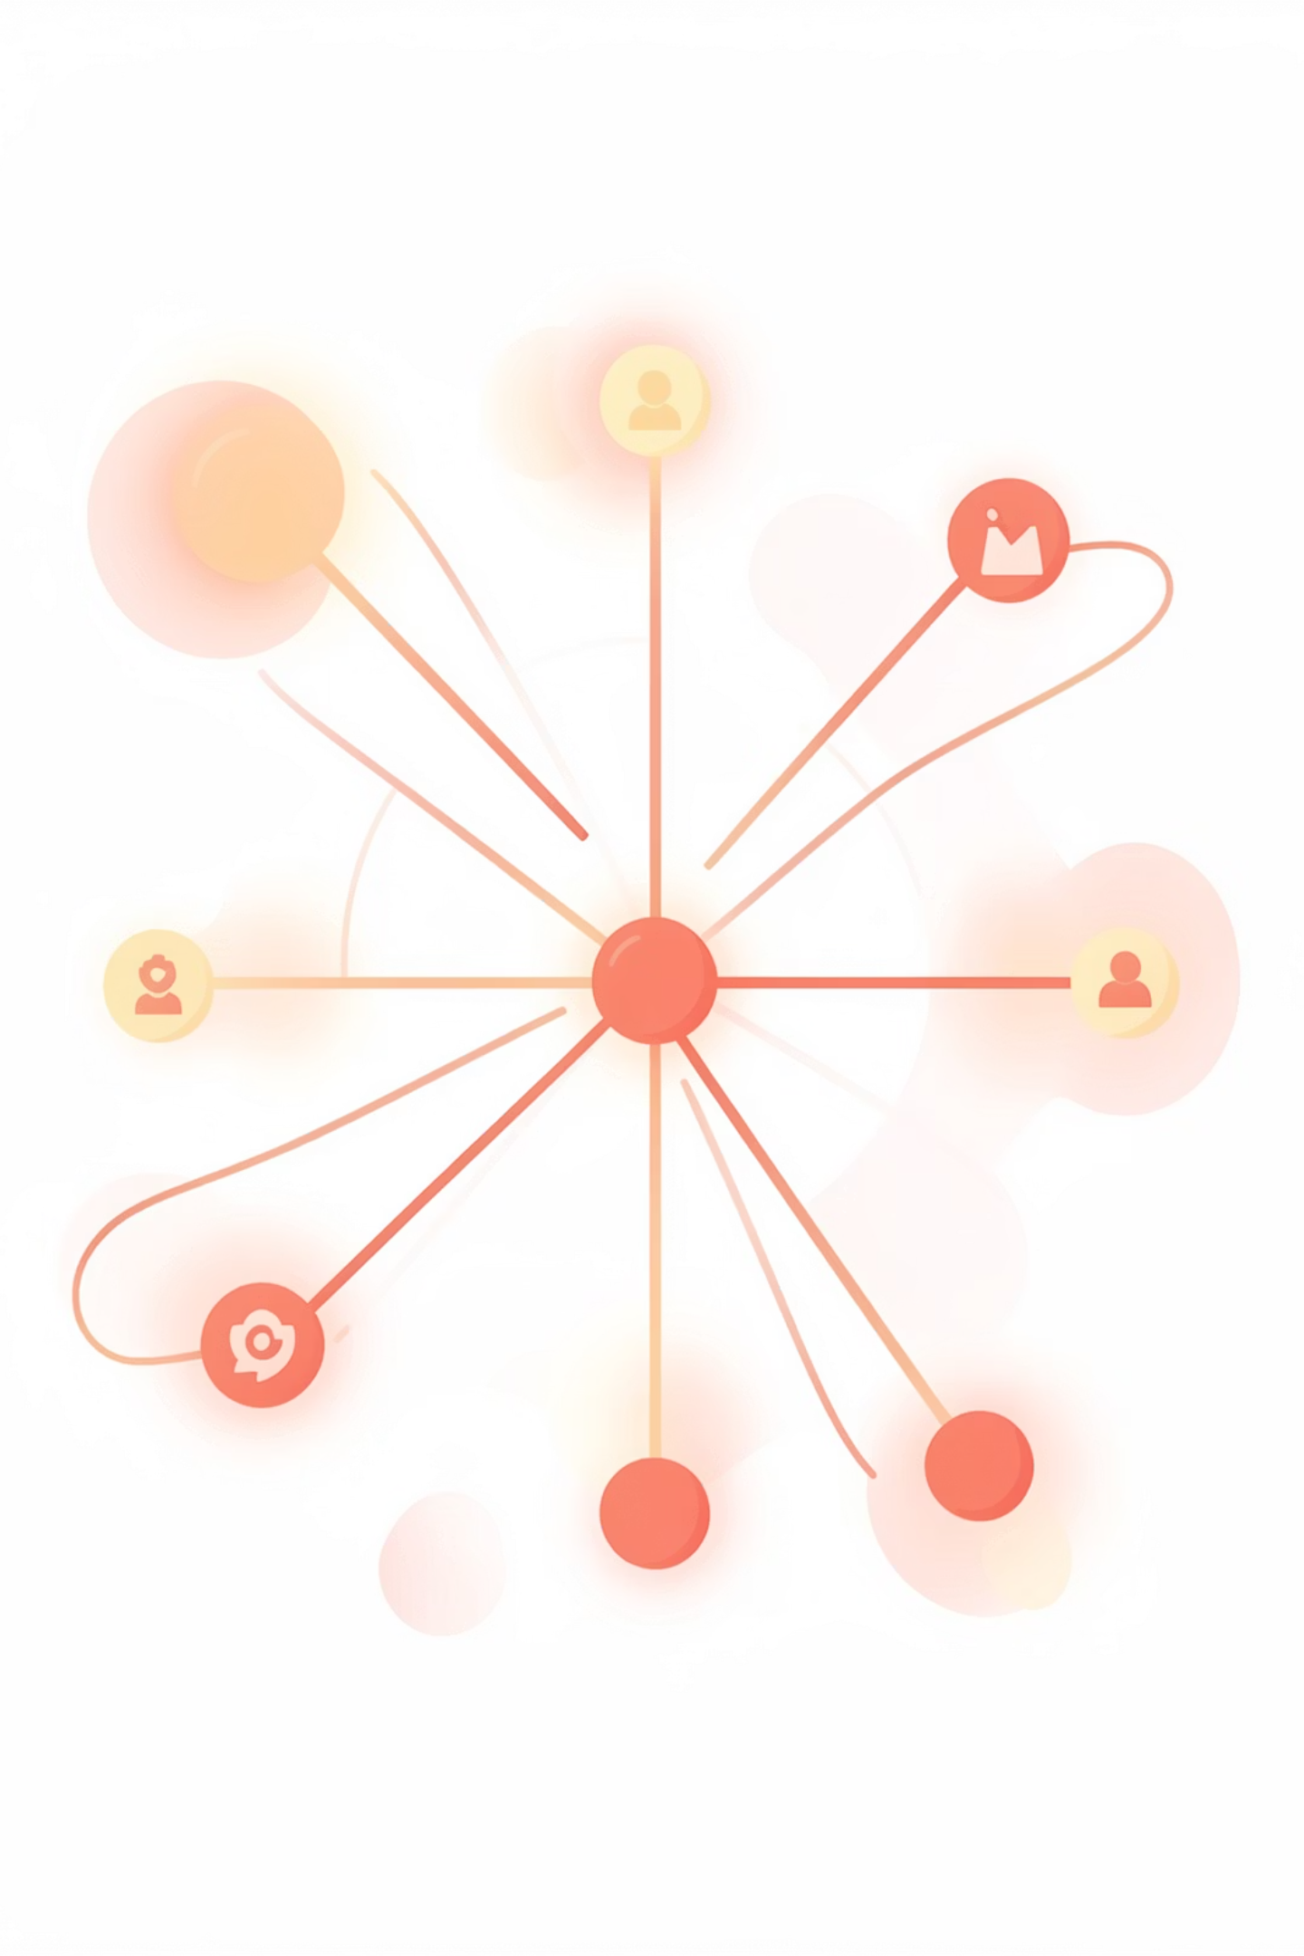
Customer Shopping Behavior Analysis
This project analyzes transactional data to uncover insights into spending patterns, customer segments, product preferences, and subscription behavior, guiding strategic business decisions.

Slide 2

Project Overview & Dataset Summary
Project Goal
Dataset Snapshot
Analyze 3,900 purchases to understand customer behavior, product preferences, and subscription impact for strategic business decisions.
3,900 Rows, 18 Columns
Key Features: Demographics, Purchase Details, Behavior
Missing Data: 37 values in Review Rating

Slide 3



Exploratory Data Analysis (EDA) in Python
Data Loading & Exploration
Missing Data Handling
Imported data with pandas, used df.info() and .describe() for initial structure and statistics.
Imputed missing 'Review Rating' values using the median rating per product category.
Column Standardization
Feature Engineering
Renamed columns to snake_case for improved readability and documentation.
Created age_group by binning ages and purchase_frequency_days from purchase data.

Slide 4
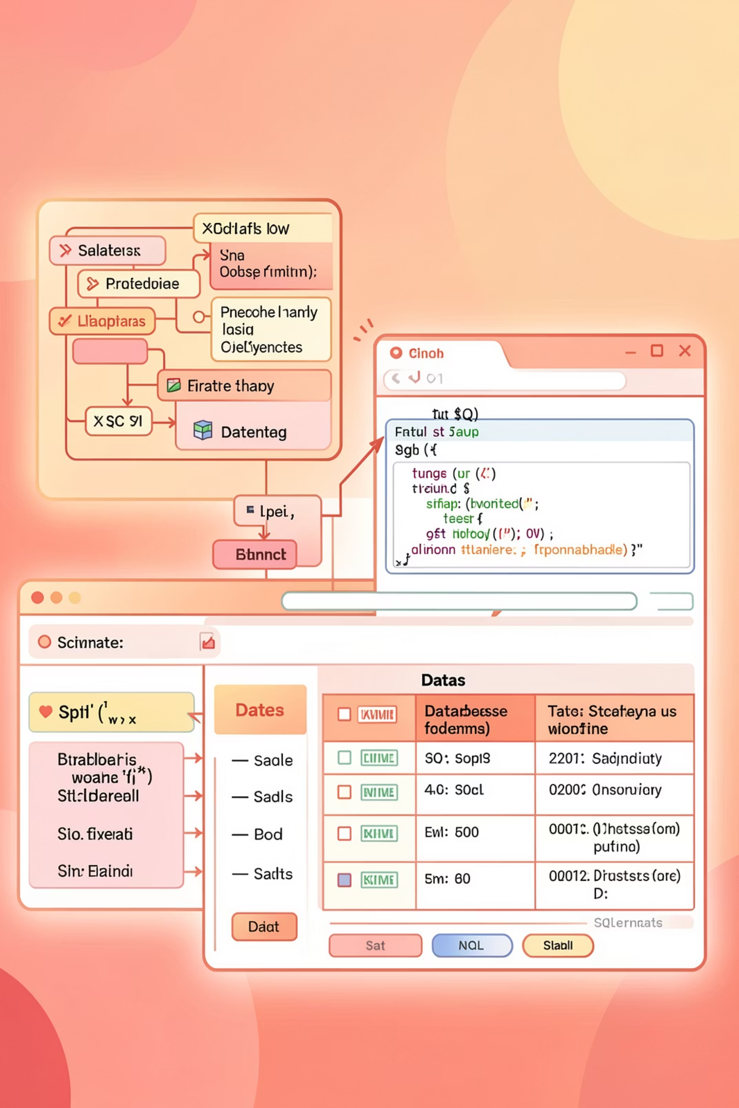
Data Analysis using SQL: Key Business Insights
Revenue by Gender
Top 5 Products by Rating
Male customers generated $157,890, significantly more than female customers ($75,191).
Gloves (3.86), Sandals (3.84), Boots (3.82), Hat (3.80), and Skirt (3.78) received the highest average ratings.
High-Spending Discount Users
Shipping Type Comparison
Identified 839 customers who used discounts but still spent above average.
Express shipping had a slightly higher average purchase amount ($60.48) than Standard ($58.46).

Slide 5
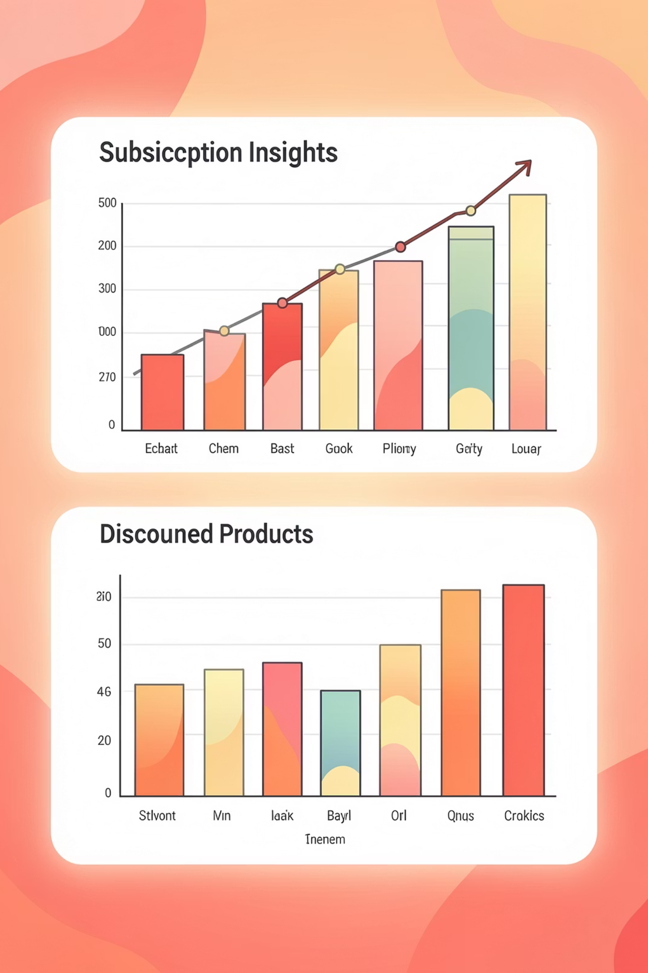
SQL Insights: Subscriptions & Discounts
Subscribers vs. Non-Subscribers
Discount-Dependent Products
Non-subscribers (2847) contributed more total revenue ($170,436) than subscribers (1053, $62,645).
Products like Hat (50%), Sneakers (49.66%), and Coat (49.07%) had the highest percentage of discounted purchases.

Slide 6

SQL Insights: Customer Segmentation
Loyal Customers
Returning Customers
3,116 customers classified as Loyal, indicating strong retention.
701 customers identified as Returning, showing repeat engagement.
New Customers
83 new customers, highlighting growth opportunities.

Slide 7

SQL Insights: Product Performance & Age Groups
Top Products per Category
Revenue by Age Group
Young Adult: $62,143
Middle-aged: $59,197
Adult: $55,978
Senior: $55,763
Accessories: Jewelry, Sunglasses, Belt
Clothing: Blouse, Pants, Shirt
Footwear: Sandals, Shoes, Sneakers
Outerwear: Jacket, Coat

Slide 8
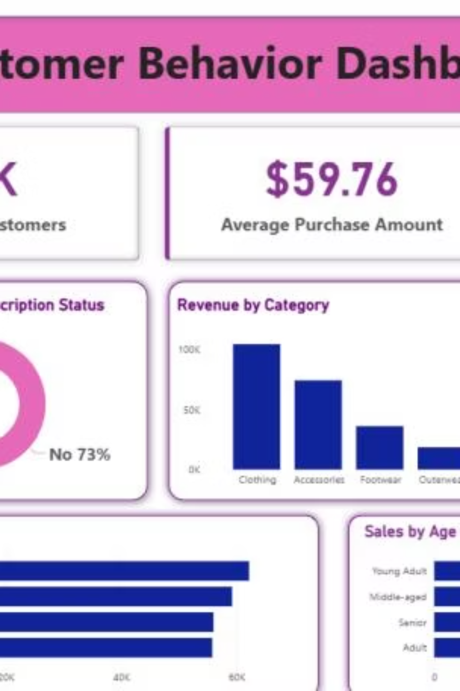
Power BI Dashboard: Visualizing Customer Behavior
The interactive Power BI dashboard provides a comprehensive visual summary of customer behavior, including key metrics and trends.

Slide 9
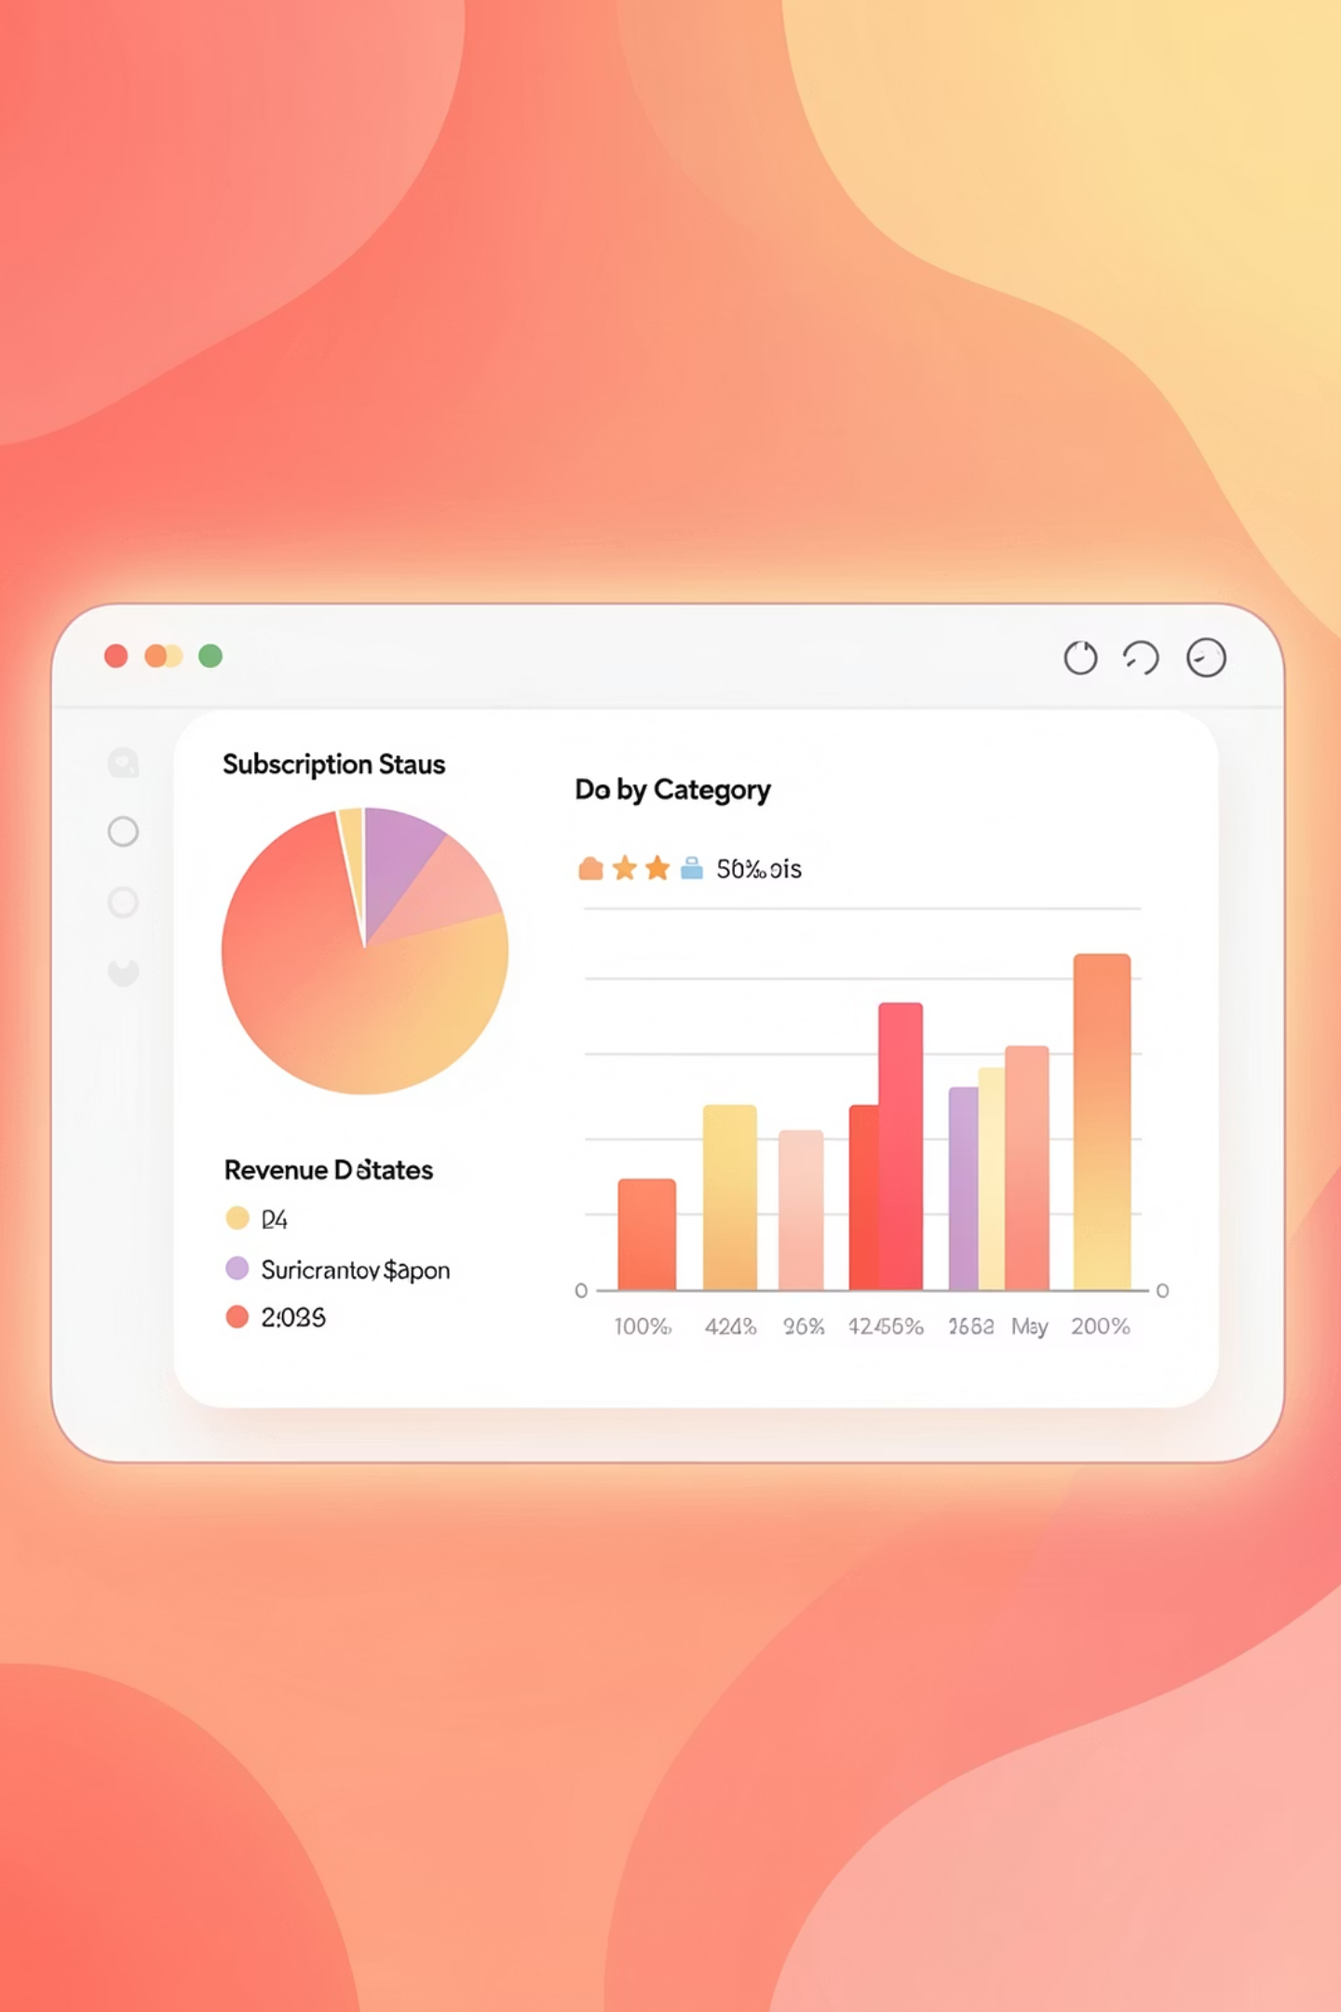
Dashboard Highlights
Key Metrics
Revenue by Category
3.9K Customers
$59.76 Average Purchase
3.75 Average Review Rating
Clothing: $100K
Accessories: $70K
Footwear: $40K
Outerwear: $20K
Subscription Status
73% of customers are non-subscribers, 27% are subscribers.
Revenue by Age Group
Young Adults generate the highest revenue ($45K).

Slide 10
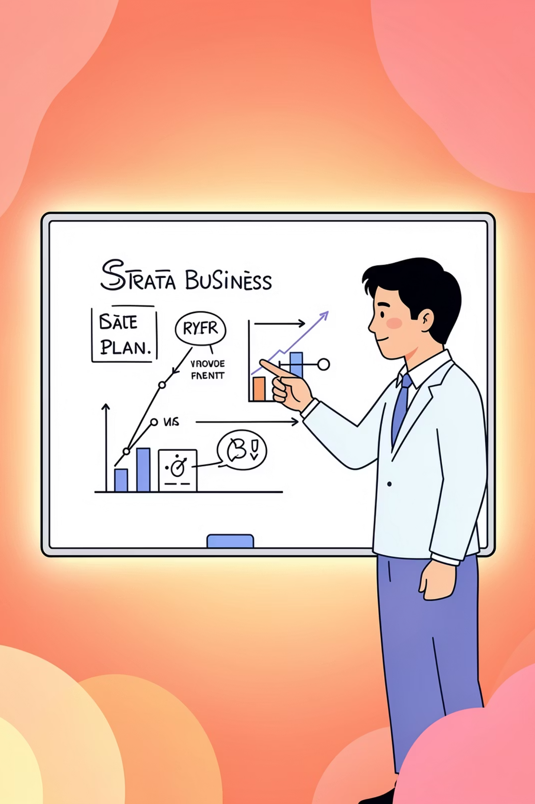

Business Recommendations
Boost Subscriptions
Promote exclusive benefits to increase subscriber base.
Customer Loyalty Programs
Implement rewards for repeat buyers to foster loyalty.
Review Discount Policy
Optimize discounts to balance sales growth and profit margins.
Targeted Marketing
Focus campaigns on high-revenue age groups and express-shipping users.

